Slide 1
Introduction:
Risk-Return Trade-offs
Chapter 1

Slide 2
Risk vs Return
There is a trade off between risk and expected return
The higher the risk, the higher the expected return

Slide 3
Example (Table 1.1, page 3)
Suppose Treasuries yield 5% and the returns for an equity investment are:
Probability | Return
0.05 | +50%
0.25 | +30%
0.40 | +10%
0.25 | –10%
0.05 | –30%

Slide 4
Example continued
We can characterize investments by their expected return and standard deviation of return
For the equity investment:
  Expected return =10%
  Standard deviation of return =18.97%

Slide 5
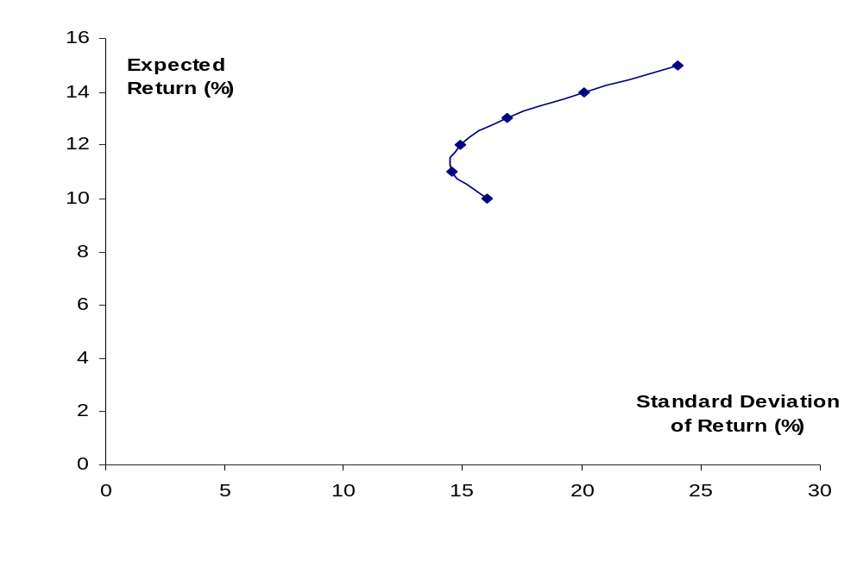
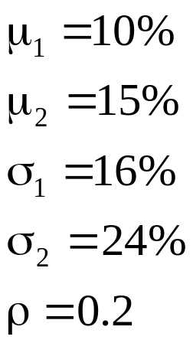
Combining Two Risky Investments (page 5)

Slide 6
Efficient Frontier of Risky Investments (Figure 1.3, page 6)
Efficient Frontier
Expected Return
Investments
S.D. of Return

Slide 7
Efficient Frontier of All Investments (Figure 1.4, page 7)
J
Expected Return
M
E(R_{M})
I
Previous Efficient Frontier
R_{F}
F
New Efficient Frontier
S.D. of Return
σ_{M}

Slide 8
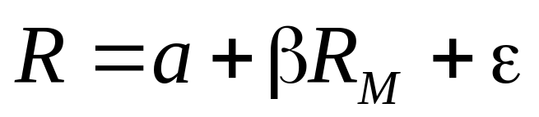
Systematic vs Non-Systematic Risk (equation 1.3, page 8)
We can calculate the best fit linear relationship between return from investment and return from market
Systematic Risk (non-diversifiable)
Non-systematic risk (diversifiable)

Slide 9

The Capital Asset Pricing Model (Figure 1.5, page 9)
Expected Return E(R)
E(R_{M})
R_{F}
Beta
1.0

Slide 10
Assumptions
Investors care only about expected return and SD of return
The ε’s of different investments are independent
Investors focus on returns over one period which has the same length for all investors
All investors can borrow or lend at the same risk-free rate
Tax does not influence investment decisions
All investors make the same estimates of μ’s, σ’s and ρ’s.

Slide 11
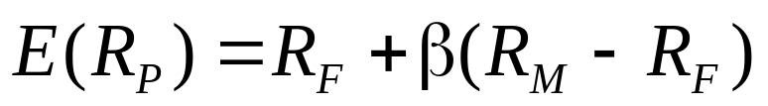
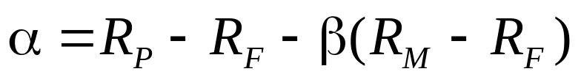
Alpha
Alpha measure the extra return on a portfolio in excess of that predicted by CAPM
so that

Slide 12
Arbitrage Pricing Theory
Returns depend on several factors
We can form portfolios to eliminate the dependence on the factors
This leads to result that expected return is linearly dependent on the realization of the factors

Slide 13
Risk vs Return for Companies
If shareholders care only about systematic risk, should the same be true of company managers?
In practice companies are concerned about total risk
Earnings stability and company survival are important managerial objectives
The regulators of financial institutions are primarily interested in total risk
“Bankruptcy costs” arguments show that that managers may be acting in the best interests of shareholders when they consider total risk

Slide 14
What Are Bankruptcy Costs? (Business Snapshot 1.1)
Lost sales (There is a reluctance to buy from a bankrupt company.)
Key employees leave
Legal and accounting cost
Etc.

Slide 15
Approaches to Bank Risk Management
Risk aggregation: aims to get rid of non-systematic risks with diversification
Risk decomposition: tackles risks one by one
In practice banks use both approaches

Slide 16
Credit Ratings
Moody’s | S&P and Fitch
Aaa | AAA
Aa | AA
A | A
Baa | BBB
Ba | BB
B | B
Caa | CCC
Ca | CC
C | C
Investment grade bonds
Non-investment grade bonds

Slide 17
Subdivisions
Moody’s divides Aa into Aa1, Aa2, Aa3.
S&P and Fitch divide AA into AA+, AA, and AA−
Other rating categories are subdivided similarly except AAA (Aaa) and the two lowest categories.

